Slide 1

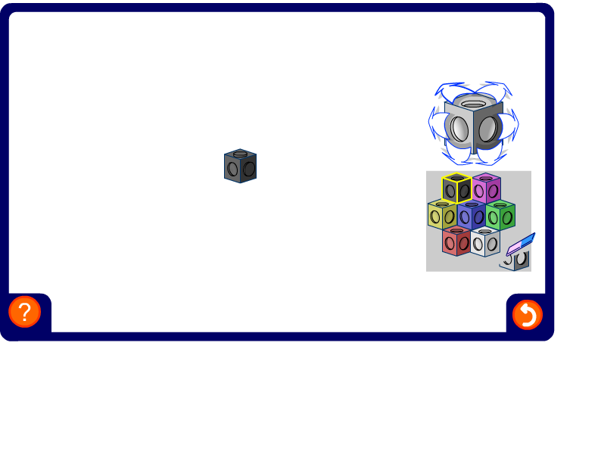


Symmetry in 3-D shapes
Notes:
Ask volunteers to come to the board and make three-dimensional shapes with given numbers of planes of symmetry. If other member of the group believe the shape constructed has more (or less) planes of symmetry, they should describe these fully and give an alternative shape.
Ask pupils to describe the number of axes of rotational symmetry and the order of rotational symmetry about each axis for each 3-D shape.

